Slide 1
Course Title -DBMS
Topic Title –
Multiple Granularity Deadlock Handling
Presenter’s Name - Chandrika
Presenter’s ID - IARE11147
Department Name - CSE ( Artificial Intelligence, and Machine Learning )

Slide 2
Multiple Granularity Deadlock Handling
Granularity
It is the size of the data item allowed to lock. Now Multiple Granularity means hierarchically breaking up the database into blocks that can be locked and can be tracked what needs to lock and in what fashion. Such a hierarchy can be represented graphically as a tree.
For example, consider the tree, which consists of four levels of nodes. The highest level represents the entire database. Below it is nodes of type area; the database consists of exactly these areas. The area has children nodes which are called files. Every area has those files that are its child nodes. No file can span more than one area.
Finally, each file has child nodes called records. As before, the file consists of exactly those records that are its child nodes, and no record can be present in more than one file. Hence, the levels starting from the top level are:
Database , area , file , record

Slide 3
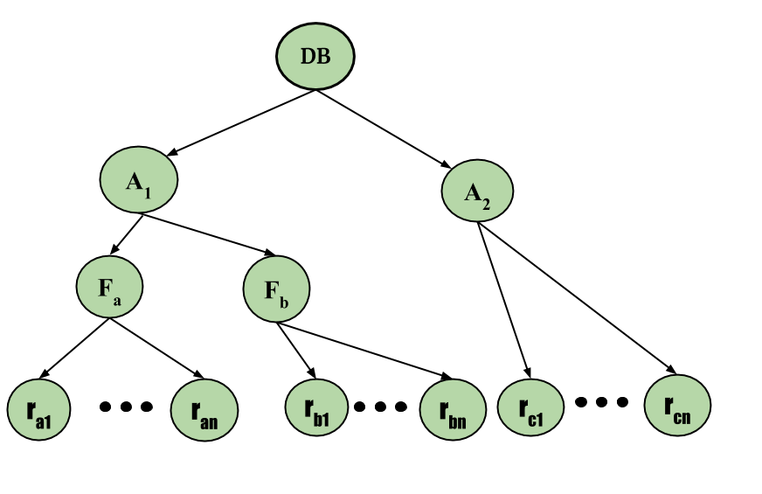
Multiple Granularity Deadlock Handling

Slide 4
Multiple Granularity Deadlock Handling
Deadlock is a situation where a process or a set of processes is blocked, waiting for some other resource that is held by some other waiting process. It is an undesirable state of the system. In other words, Deadlock is a critical situation in computing where a process, or a group of processes, becomes unable to proceed because each is waiting for a resource that is held by another process in the same group. This scenario leads to a complete standstill, rendering the affected processes inactive and the system inefficient.

Slide 5
Multiple Granularity Deadlock Handling
Necessary Condition for a Deadlock
The following are the four conditions that must hold simultaneously for a deadlock to occur.
Mutual Exclusion: A resource can be used by only one process at a time. If another process requests for that resource, then the requesting process must be delayed until the resource has been released.
Hold and wait: Some processes must be holding some resources in the non-shareable mode and at the same time must be waiting to acquire some more resources, which are currently held by other processes in the non-shareable mode.
No pre-emption: Resources granted to a process can be released back to the system only as a result of voluntary action of that process after the process has completed its task.
Circular wait: Deadlocked processes are involved in a circular chain such that each process holds one or more resources being requested by the next process in the chain.

Slide 6
Multiple Granularity Deadlock Handling
Methods of Handling Deadlocks
There are four approaches to dealing with deadlocks.
1. Deadlock Prevention 2. Deadlock avoidance (Banker's Algorithm) 3. Deadlock detection & recovery 4. Deadlock Ignorance (Ostrich Method)

Slide 7
Thank You

